Slide 1
Introduction to CS162
David E. Culler
CS162 – Operating Systems and Systems Programming
http://cs162.eecs.berkeley.edu/
Lecture 1
August 29, 2014
Read A&D Ch1
HW0 out, due 9/8

Slide 2
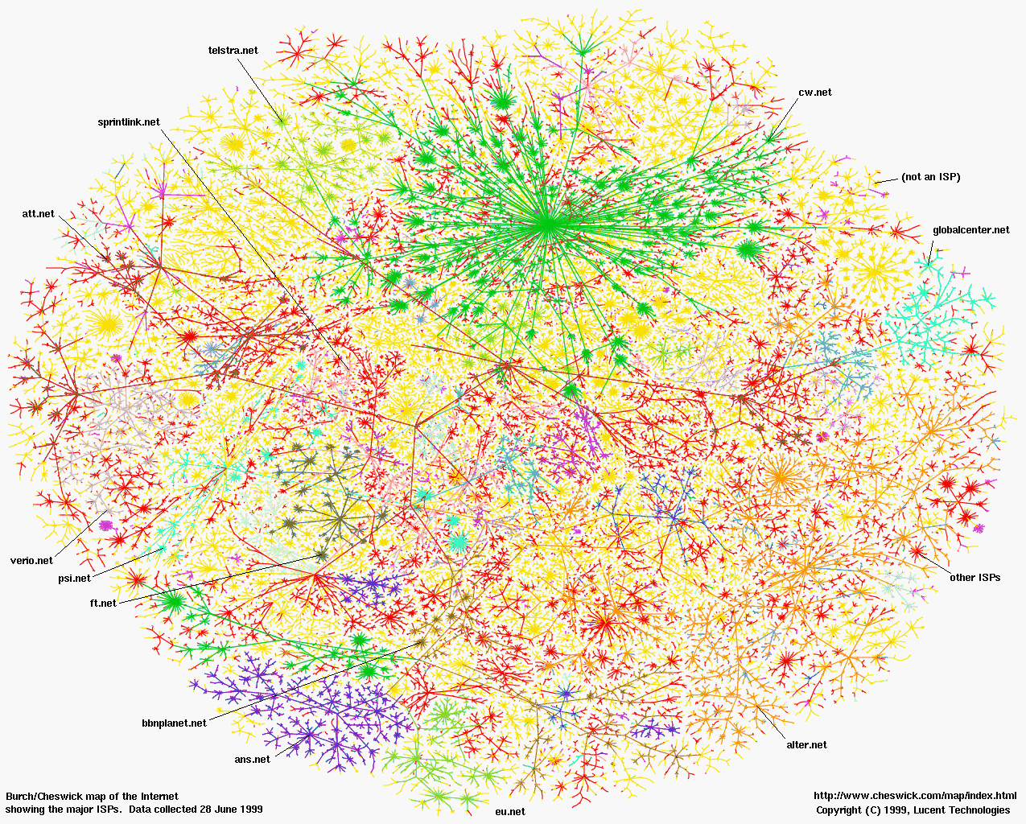
Greatest Artifact of Human Civilization …

Slide 3


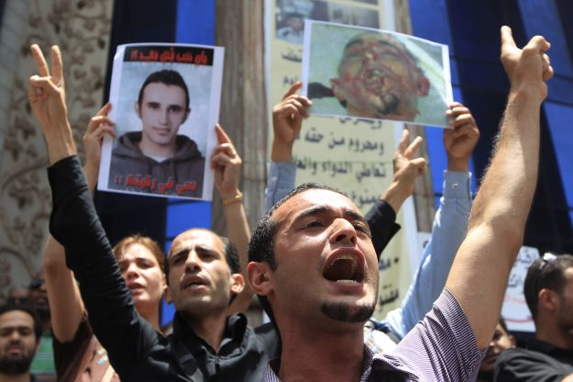
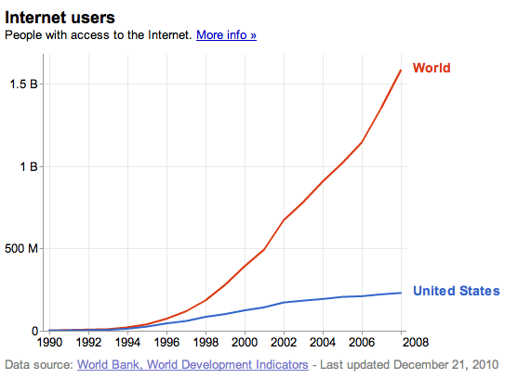
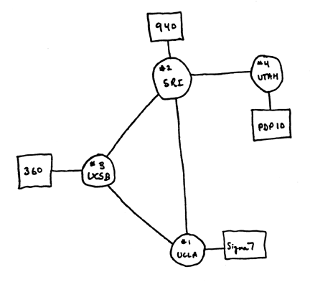
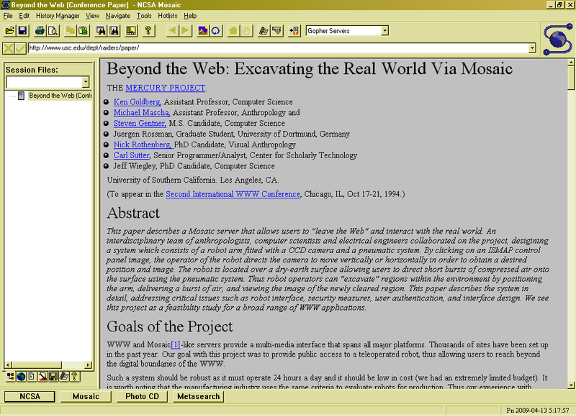
3 Billion by …
2.8 B
Internet
WWW
2.0 B 1/26/11
ARPANet
RFC 675 TCP/IP
HTTP 0.9
1969
1974
1990
2010

Slide 4
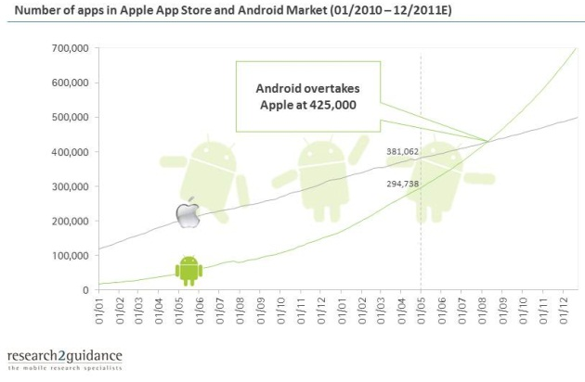
Operating Systems at the heart of it all …
Make the incredible advance in the underlying hardware available to a rapid evolving body of applications.
Processing, Communications, Storage, Interaction
The key building blocks
Scheduling
Concurrency
Address spaces
Protection, Isolation, Security
Networking, distributed systems
Persistent storage, transactions, consistency, resilience
Interfaces to all devices

Slide 5
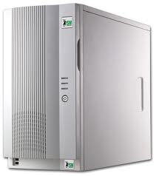
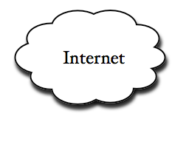
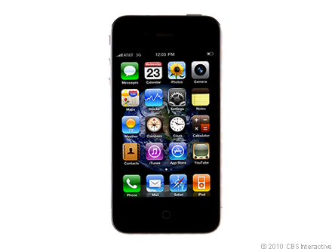
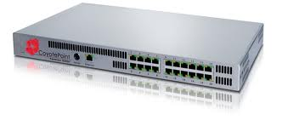
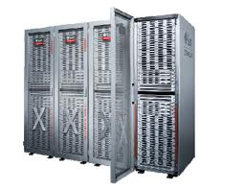
Example: What’s in a Search Query?
DNS
Servers
Datacenter
DNS
request
create
result
page
Search
Index
Page store
Load
balancer
Ad Server
Complex interaction of multiple components in multiple administrative domains
Systems, services, protocols, …
Notes:
In this course we are not focusing on a single node system but on the end-to-end system. The reason is very simple: today the majority of applications we use does not run on our system. Social networks, e-mail, google docs, online gamming, etc.

Slide 6
Why take CS162?
Some of you will actually design and build operating systems or components of them.
Perhaps more now than ever
Many of you will create systems that utilize the core concepts in operating systems.
Whether you build software or hardware
The concepts and design patterns appear at many levels
All of you will build applications, etc. that utilize operating systems
The better you understand their design and implementation, the better use you’ll make of them.

Slide 7
Today’s Objectives
Introduce you to Operating System design
Introduce the CS162 instructional team
Establish expectations and logistics
Maybe get a little excited about how OS is so essential in creating and advancing this “connected world”

Slide 8

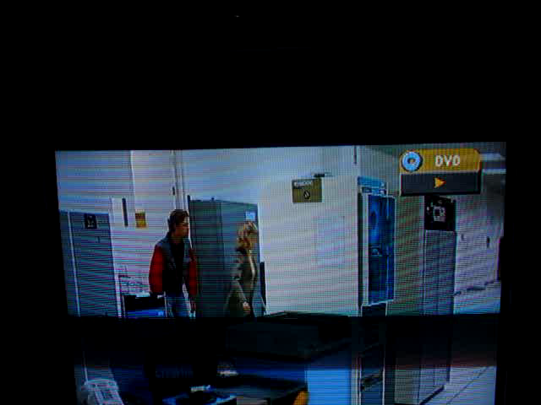
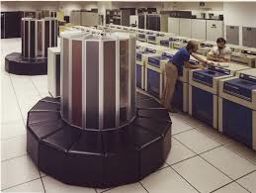
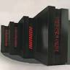
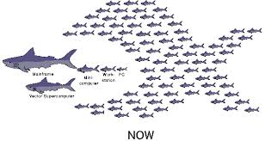
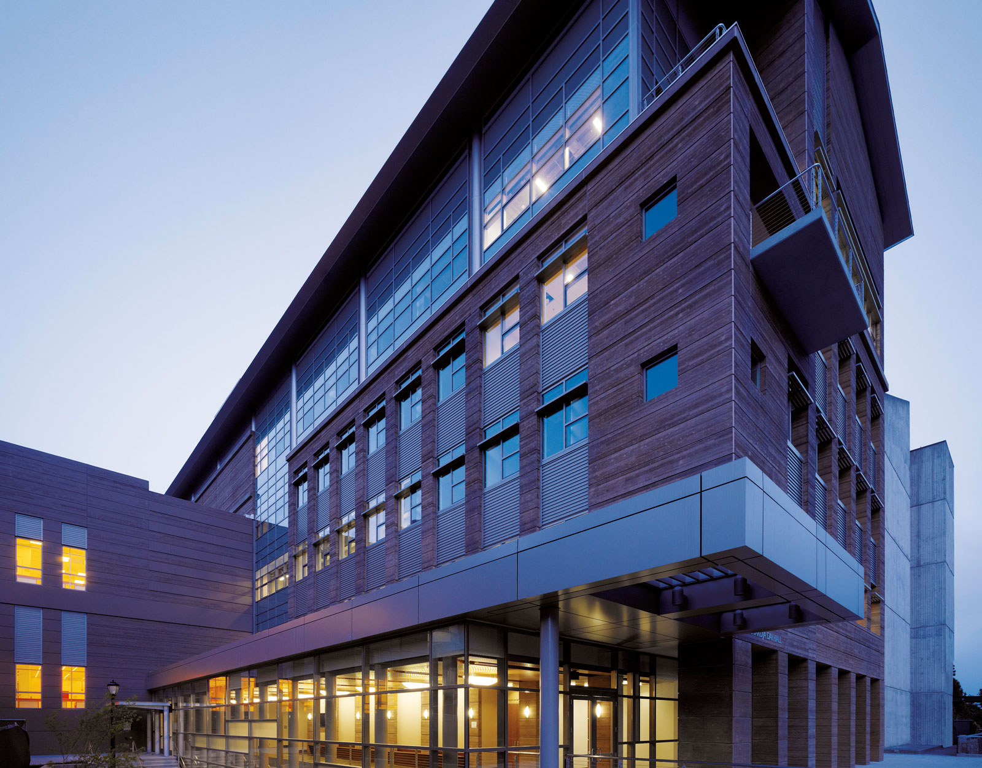
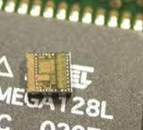
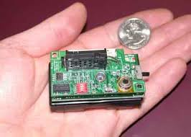
CS162 Team - me
David Culler (culler@berkeley.edu)
465 Soda Hall (amplab)
http://www.cs.berkeley.edu/~culler
Office hours: M 2-3, Tu 9-10, W 2-3 in 449 Soda
Bit’o systems experience
Cray Time Sharing System
Active Messages
Massive High Performance Clusters
TinyOS / Berkeley Motes
BOSS

Slide 9
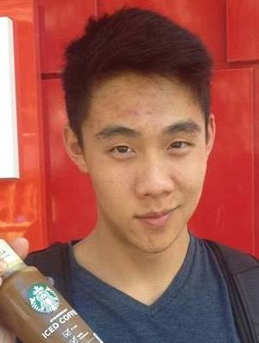

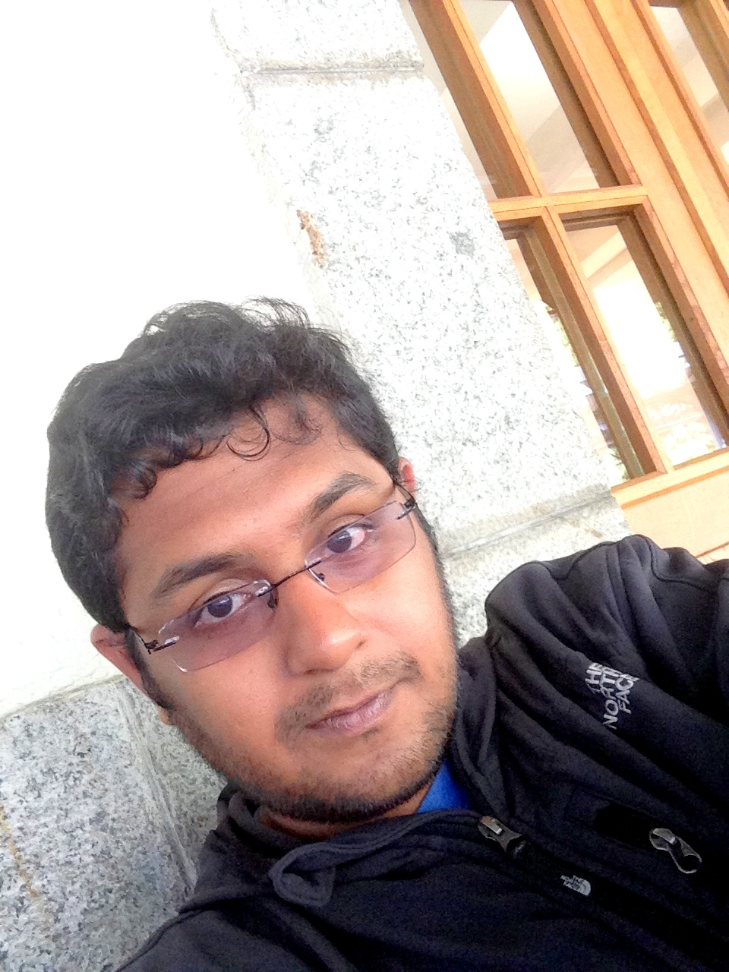
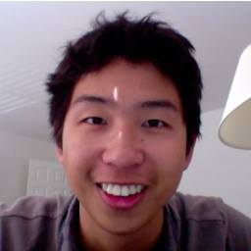
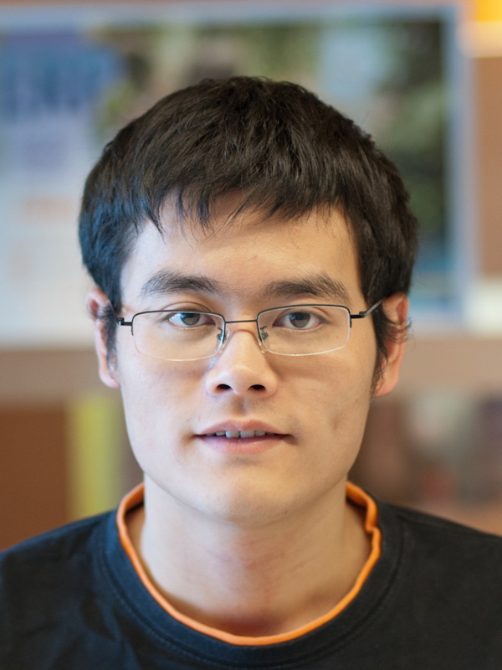
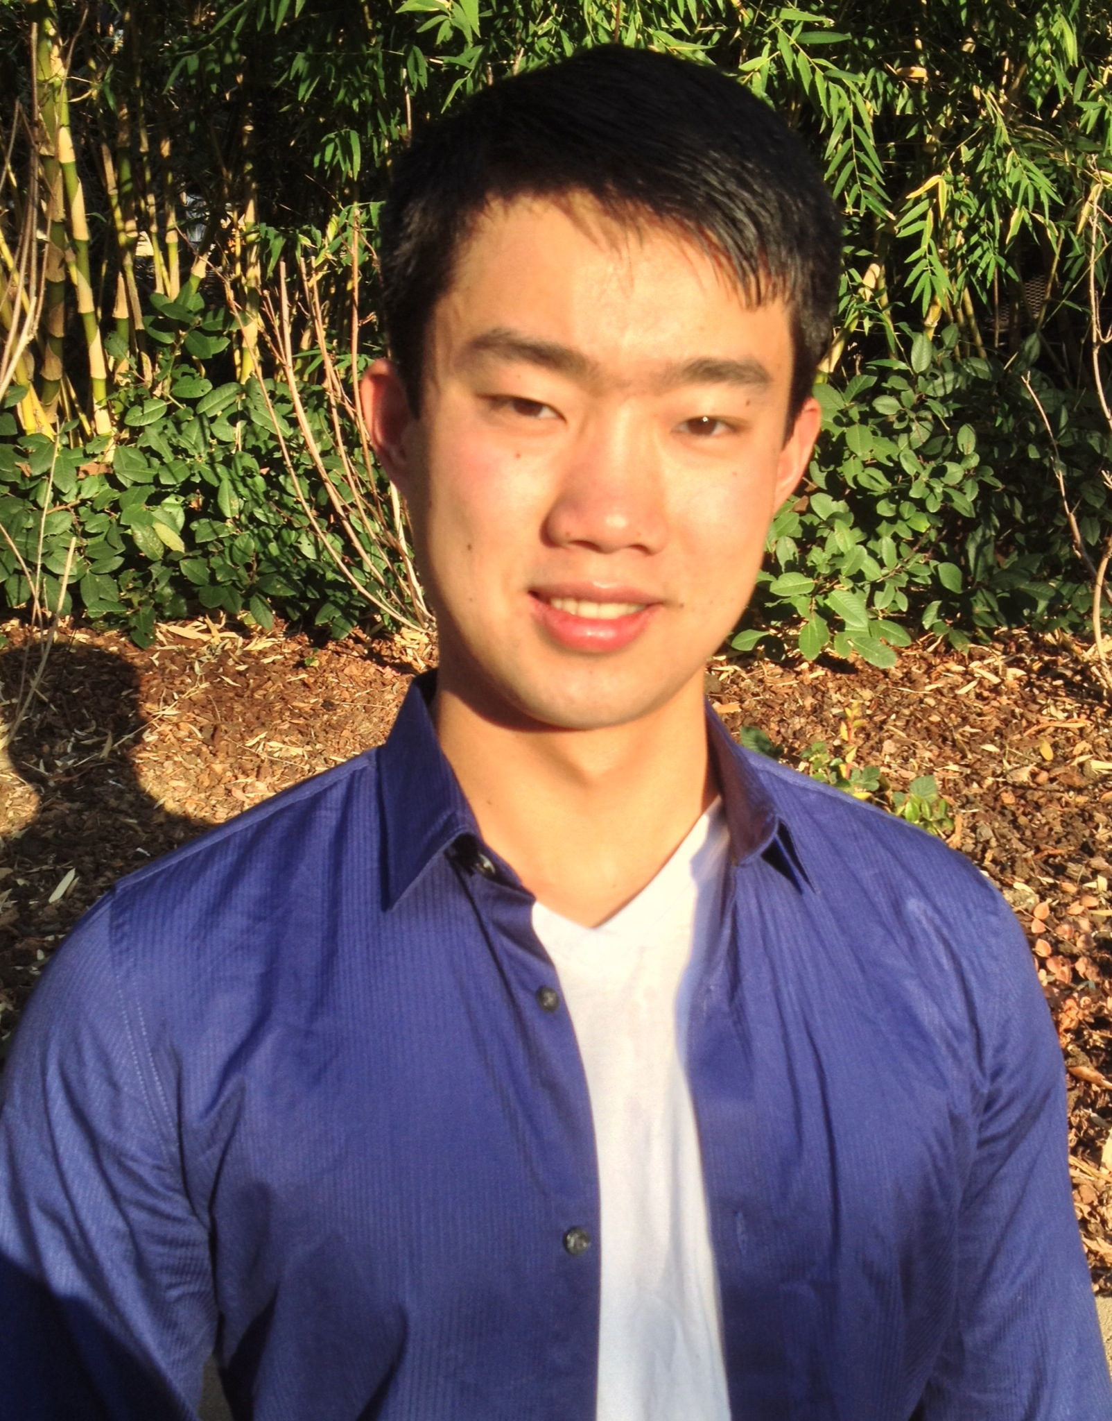
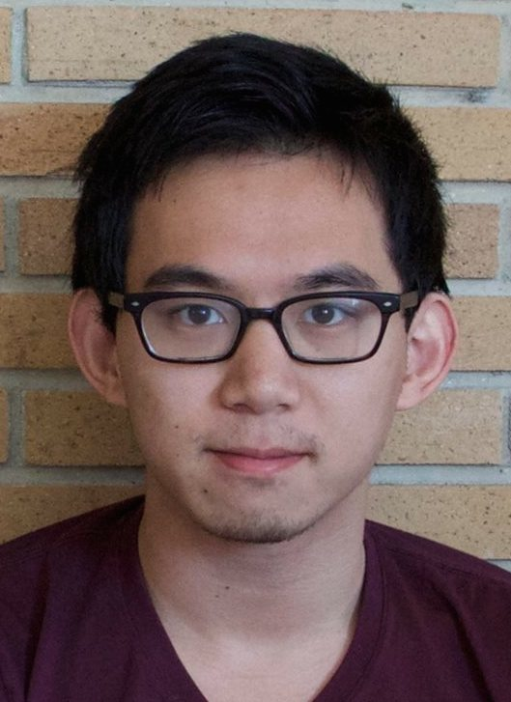
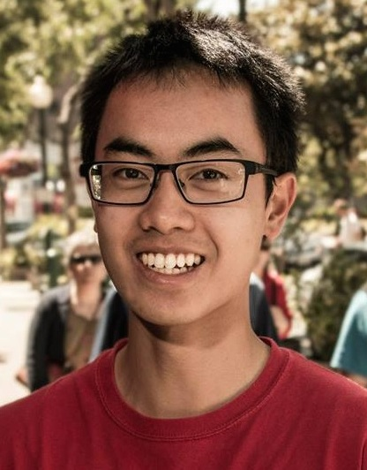
CS162 Team - GSIs
Vaishaal Shankar
Head GSI,
cs162-ta@inst.eecs.berkeley.edu
Sec 108: W 4-5
OH: Tu/Th 5-6, 751 Soda
Arka Bhattacharya
cs162-tb@inst.eecs.berkeley.edu
Sec: 107 W 3-4, 105 Th 12-1
OH: W 5:30-7:30, 411 Soda
Kaifei Chen
cs126-tc@inst.eecs.berkeley.edu
Sec: 109 Th 10-11
OH: Tu 9-11am, 411 Soda
Stanley Hung
cs162-td@inst.eecs.berkeley.edu
Sec: 106 Th 1-2
OH: Tu/Th 2-3, 611 Soda
Jason Jia
cs162-te@inst.eecs.berkeley.edu
Sec: 101 W 3-4
OH: Tu/Th 1-2pm, Soda 651
Will Liu
cs162-tf@inst.eecs.berkeley.edu
Sec: 102 W 4-5
OH: Tu/Th 3-4 pm, 611 Soda
Issac Tian
cs162-tg@inst.eecs.berkeley.edu
Sec: 103 Th 10-11
OH: Wed 1:30-2:30, 651 Soda
Caleb Wang
cs162-th@inst.eecs.berkeley.edu
Sec: 104 Th 11-12
OH: Mon 2-4 pm, 751 Soda

Slide 10
What is an operating system?
Special layer of software that provides application software access to hardware resources
Convenient abstraction of complex hardware devices
Protected access to shared resources
Security and authentication
Communication amongst logical entities
appln
appln
appln
OS
Hardware

Slide 11
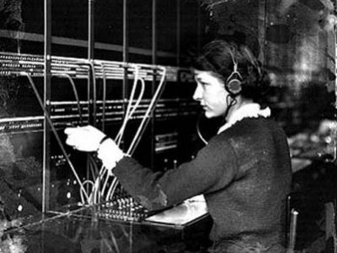
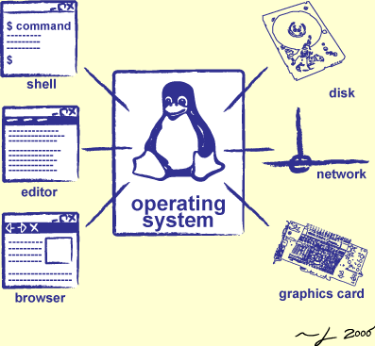
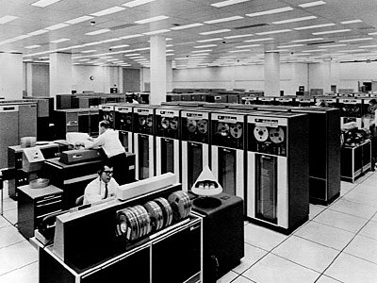
Operator …
Switchboard Operator
Computer Operators

Slide 12
What make something a system?

Slide 13
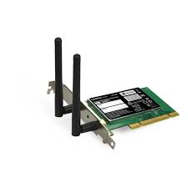
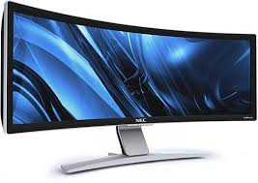

OS Basics: “Virtual Machine” Boundary
Threads
Address Spaces
Windows
Processes
Files
Sockets
Software
OS Hardware Virtualization
Hardware
ISA
Memory
Processor
Networks
storage
Displays
Inputs

Slide 14
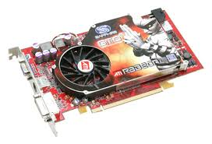
OS Basics: Program => Process
Threads
Address Spaces
Windows
Processes
Files
Sockets
Software
OS Hardware Virtualization
Hardware
ISA
Memory
Processor
OS
storage
Networks
Displays
Inputs

Slide 15
OS Basics: Context Switch
Threads
Address Spaces
Windows
Processes
Files
Sockets
Software
OS Hardware Virtualization
Hardware
ISA
Memory
Processor
OS
storage
Networks
Displays
Inputs

Slide 16
OS Basics: Scheduling, Protection
Threads
Address Spaces
Windows
Processes
Files
Sockets
Software
OS Hardware Virtualization
Hardware
ISA
Memory
Processor
Protection Boundary
OS
storage
Networks
Displays
Inputs

Slide 17
OS Basics: I/O
Threads
Address Spaces
Windows
Processes
Files
Sockets
Software
OS Hardware Virtualization
Hardware
ISA
Memory
Processor
Protection Boundary
OS
Ctrlr
storage
Networks
Displays
Inputs

Slide 18
OS Basics: Loading
Threads
Address Spaces
Windows
Processes
Files
Sockets
Software
OS Hardware Virtualization
Hardware
ISA
Memory
Processor
Protection Boundary
OS
Ctrlr
storage
Networks
Displays
Inputs

Slide 19
Course Structure: Spiral
File Systems (8)
Address Space (4)
Concurrency (6)
Reliability, Security, Cloud (8)
Distributed Systems (8)
OS Concepts (3)
intro

Slide 20
Syllabus
OS Concepts (3)
Process, I/O, Networks and VM
Concurrency (6)
Threads, scheduling, locks, deadlock, scalability, fairness
Address Space (4)
Virtual memory, address translation, protection, sharing
File Systems (8)
i/o devices, file objects, storage, naming, caching, performance, paging, transactions, databases
Distributed Systems (8)
Protocols, N-Tiers, RPC, NFS, DHTs, Consistency, Scalability, multicast
Reliability & Security
Fault tolerance, protection, security
Cloud Infrastructure

Slide 21
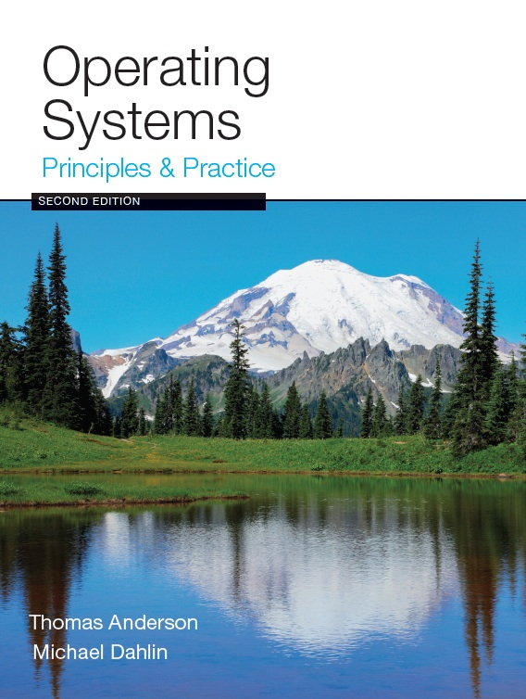
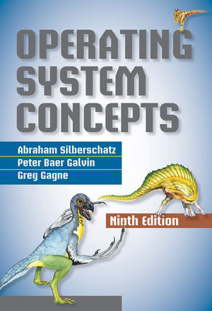
Textbook & Readings
Textbook: Operating Systems: Principles and Practice (2nd Edition) Anderson and Dahlin
Recommend: Operating Systems Concepts, 9th Edition Silbershatz, Galvin, Gagne
Copies in Bechtel
Online supplements
See course website
Includes Appendices, sample problems, etc.
Networking, Databases, Software Eng, Security

Slide 22
Learning by Doing
Three Group Projects
1. Threads & Scheduling (Pintos in C )
2. User-programs (Pintos in C)
3. Key-value store (Java)
Individual Homework (1-2 weeks)
0. Tools, Autograding, recall C, executable
1. Simple Shell
2. Web server
…

Slide 23
Group Project Simulates Industrial Environment
Project teams have 3-4 members
Must work in groups in “the real world”
Same section much perferred
Communicate with colleagues (team members)
Communication problems are natural
What have you done?
What answers you need from others?
You must document your work!!!
Communicate with supervisor (TAs)
What is the team’s plan?
What is each member’s responsibility?
Short progress reports are required

Slide 24
Grading
40% midterms (~13% each)
40% projects (~13% each)
15% homework
5% participation
Project grading
[10 pts] Initial design
[10 pts] Design review
[50 pts] Code (3 checkpoints)
[30 pts] Final design
[0 pts] Peer Evaluation
Submission via git push to release branch
Triggers autograder
Regular git push so TA sees your progress

Slide 25
Getting started
Start homework 0 immediately
Gets cs162-xx@cory.eecs.berkeley.edu (and other inst m/c)
Github account
Registration survey
Vagrant virtualbox – VM environment for the course
Consistent, managed environment on your machine
icluster24.eecs.berkeley.edu is same
Get familiar with all the cs162 tools
Submit to autograder via git
Go to section next week (and afterwards)
Waitlist ???

Slide 26
Personal Integrity
UCB Academic Honor Code: "As a member of the UC Berkeley community, I act with honesty, integrity, and respect for others."
http://asuc.org/honorcode/resources/HC%20Guide%20for%20Syllabi.pdf

Slide 27


CS 162 Collaboration Policy
Explaining a concept to someone in another group
Discussing algorithms/testing strategies with other groups
Helping debug someone else’s code (in another group)
Searching online for generic algorithms (e.g., hash table)
Sharing code or test cases with another group
Copying OR reading another group’s code or test cases
Copying OR reading online code or test cases from from prior years
We compare all project submissions against prior year submissions and online solutions and will take actions (described on the course overview page) against offenders

Slide 28
Questions

Slide 29
What make Operating Systems exciting and Challenging

Slide 30
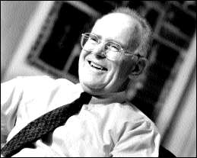
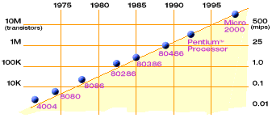
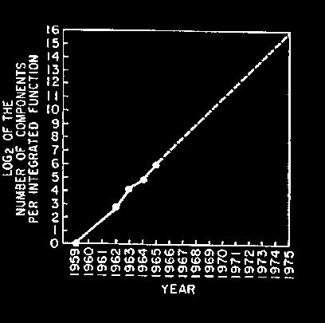
Technology Trends: Moore’s Law
Moore’s Law
2X transistors/Chip Every 1.5 years
Called “Moore’s Law”
Gordon Moore (co-founder of Intel) predicted in 1965 that the transistor density of semiconductor chips would double roughly every 18 months.
Microprocessors have become smaller, denser, and more powerful.

Slide 31
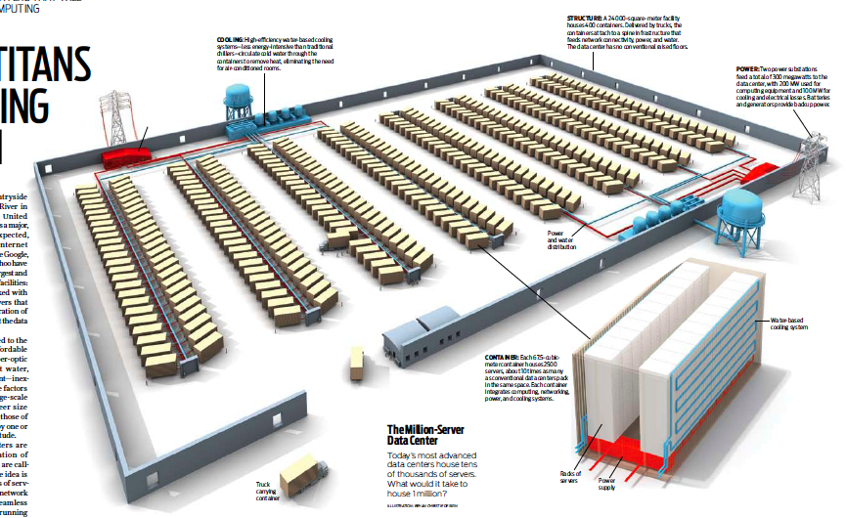
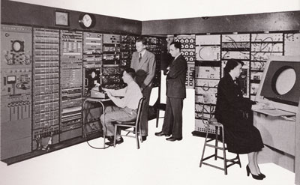
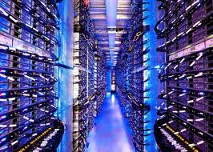
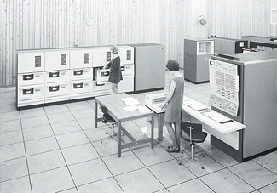
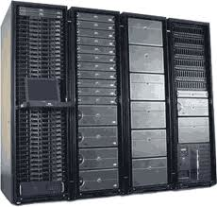
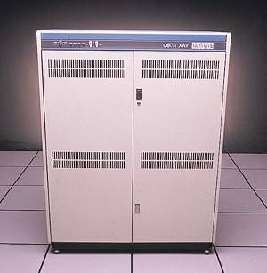
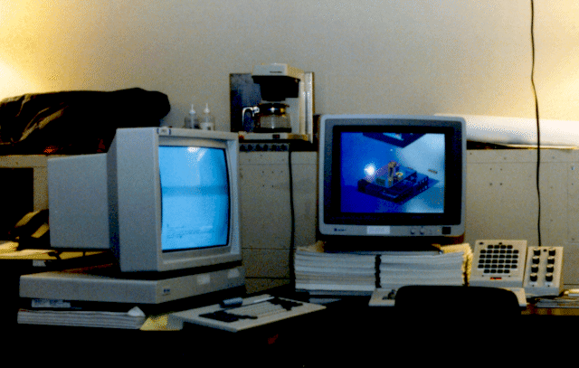
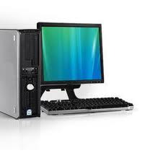
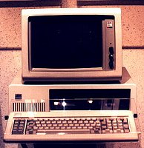
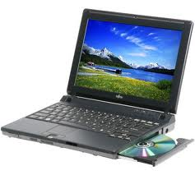
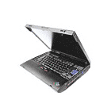
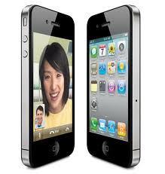
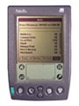
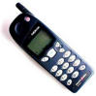

Dramatic change
Computers
Per Person
Number crunching, Data Storage, Massive Services,
Mining
1:10⁶
Mainframe
Mini
1:10³
Workstation
Productivity,
Interactive
PC
Laptop
1:1
PDA
Cell
Streaming from/to the physical world
10³:1
years
Mote!
The Internet of Things!
Bell’s Law: new computer class per 10 years

Slide 32






Computing Devices Everywhere
Notes:
What’s the largest single use of microprocessors? Not computers – Embedded computers (10 billion versus 400 million)
Example: Cellphones. Second largest? Automobiles.

Slide 33
New Challenge: Slowdown in Joy’s law of Performance
3X
From Hennessy and Patterson, Computer Architecture: A Quantitative Approach, 4th edition, Sept. 15, 2006
Joy’s Law: Perf ≈ 2^{(Year-1984)} MIPS
⇒ Sea change in chip design: multiple “cores” or processors per chip
VAX : 25%/year 1978 to 1986
RISC + x86: 52%/year 1986 to 2002
RISC + x86: ??%/year 2002 to present

Slide 34


ManyCore Chips: The future is here
Intel 80-core multicore chip (Feb 2007)
80 simple cores
Two FP-engines / core
Mesh-like network
100 million transistors
Intel Single-Chip Cloud Computer (August 2010)
24 “tiles” with two cores/tile
24-router mesh network
4 DDR3 memory controllers
Hardware support for message-passing
“ManyCore” refers to many processors/chip
64? 128? Hard to say exact boundary
How to program these?
Use 2 CPUs for video/audio
Use 1 for word processor, 1 for browser
76 for virus checking???
Parallelism must be exploited at all levels

Slide 35

Storage Capacity
Retail hard disk capacity in GB (source: http://www.digitaltonto.com/2011/our-emergent-digital-future/ )

Slide 36

Network Capacity
(source: http://www.ospmag.com/issue/article/Time-Is-Not-Always-On-Our-Side )

Slide 37

Internet Scale: .96 Billion Hosts
996,230,757
July 2013
963,518,598
https://www.isc.org/solutions/survey

Slide 38

Internet Scale: Almost 2.5 Billion Users!
(source: http://www.internetworldstats.com/stats.htm)

Slide 39

Not Only PCs connected to the Internet
Smartphone shipments now exceed PC shipments!
2011 shipments:
487M smartphones
414M PC clients
210M notebooks
112M desktops
63M tablets
25M smart TVs
4 billion phones in the world → smartphone over next decade

Slide 40











Societal Scale Information Systems
Massive Cluster
The world is a large distributed system
Microprocessors in everything
Vast infrastructure behind them
Gigabit Ethernet
Clusters
Massive Cluster
Clusters
Gigabit Ethernet
Internet Connectivity
Scalable, Reliable,
Secure Services
Databases
Information Collection
Remote Storage
Online Games
Commerce
…
MEMS for
Sensor Nets
Notes:
Of the enormous variety of CITRIS projects going on at Berkeley, I will present one set that is tied together by this picture: the design, construction and use of MEMS devices, the sensor networks containing them, and making the information from these networks available to widely distributed users as scalable, reliable and secure services.
The name we give to such an integrated system is a Societal Scale Information System, a name meant to evoke its scale – enormous - and purpose – benefiting people and the economy.
I will leave the details of all the specific applications that Ruzena mentioned, be it to energy efficiency or education or disaster response the social sciences, and indeed most details, to later talks and posters.

Slide 41
Challenge: Complexity
Applications consisting of…
… a variety of software modules that …
… run on a variety of devices (machines) that
… implement different hardware architectures
… run competing applications
… fail in unexpected ways
… can be under a variety of attacks
Not feasible to test software for all possible environments and combinations of components and devices
The question is not whether there are bugs but how serious are the bugs!

Slide 42

Increasing Software Complexity
From MIT’s 6.033 course

Slide 43
How do We Tame Complexity?
Every piece of computer hardware different
Different CPU
Pentium, ARM, PowerPC, ColdFire
Different amounts of memory, disk, …
Different types of devices
Mice, keyboards, sensors, cameras, fingerprint readers, touch screen
Different networking environment
Cable, DSL, Wireless, …
Questions:
Does the programmer need to write a single program that performs many independent activities?
Does every program have to be altered for every piece of hardware?
Does a faulty program crash everything?

Slide 44




Virtual Machines
Software emulation of an abstract machine
Give programs illusion they own the machine
Make it look like hardware has features you want
Two types of “Virtual Machine”s
Process VM: supports the execution of a single program; this functionality typically provided by OS
System VM: supports the execution of an entire OS and its applications (e.g., VMWare Fusion, Virtual box, Parallels Desktop, Xen)

Slide 45
Process VMs
Programming simplicity
Each process thinks it has all memory/CPU time
Each process thinks it owns all devices
Different devices appear to have same high level interface
Device interfaces more powerful than raw hardware
Bitmapped display ⇒ windowing system
Ethernet card ⇒ reliable, ordered, networking (TCP/IP)
Fault Isolation
Processes unable to directly impact other processes
Bugs cannot crash whole machine
Protection and Portability
Java interface safe and stable across many platforms

Slide 46

System Virtual Machines: Layers of OSs
Useful for OS development
When OS crashes, restricted to one VM
Can aid testing programs on other OSs

Slide 47



What is an Operating System?
Referee
Manage sharing of resources, Protection, Isolation
Resource allocation, isolation, communication
Illusionist
Provide clean, easy to use abstractions of physical resources
Infinite memory, dedicated machine
Higher level objects: files, users, messages
Masking limitations, virtualization
Glue
Common services
Storage, Window system, Networking
Sharing, Authorization
Look and feel

